Slide 1



WALIS
„Age is an issue of mind over matter.
If you don‘t mind, it doesn‘t matter.“
- Mark Twain

Slide 2
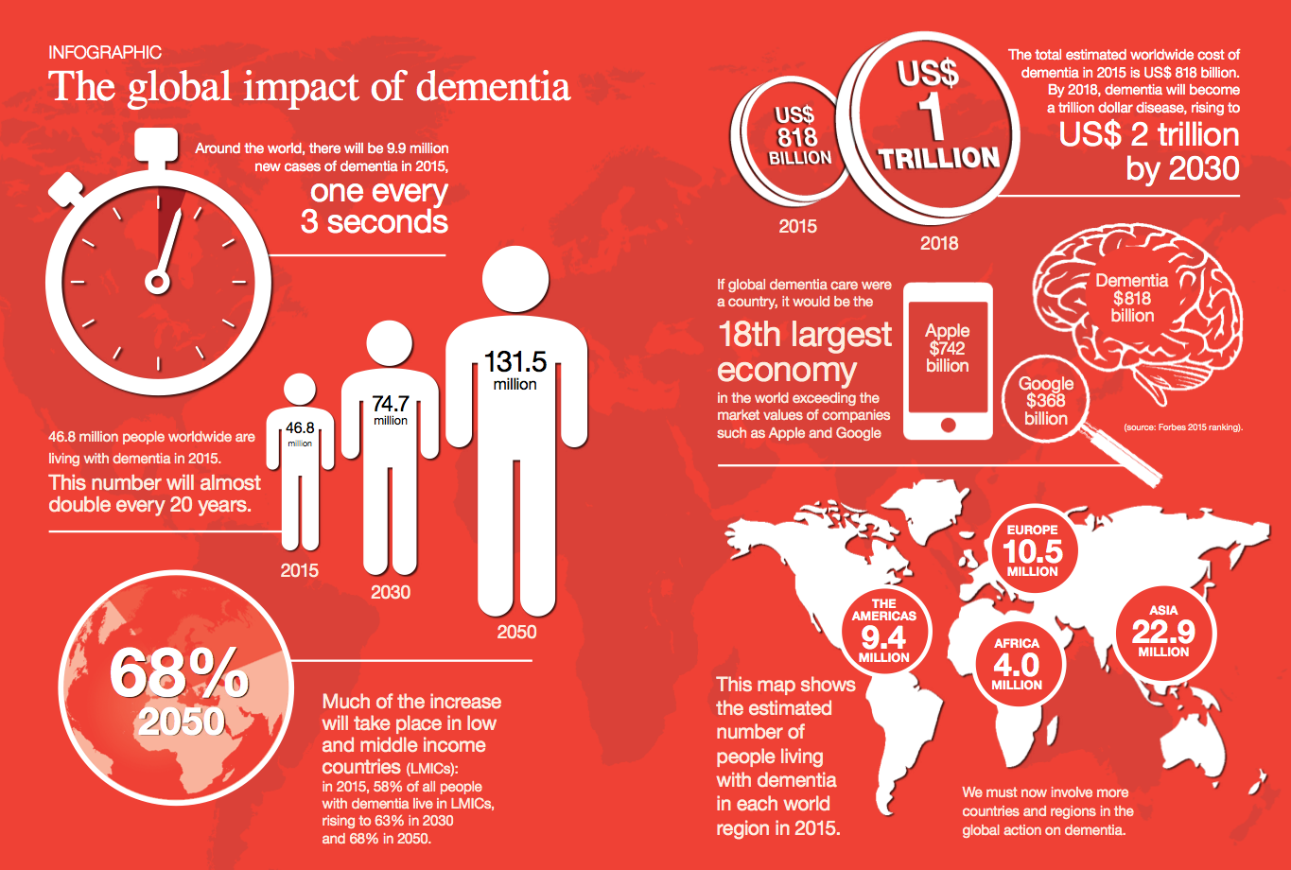

Slide 3
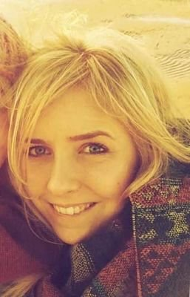

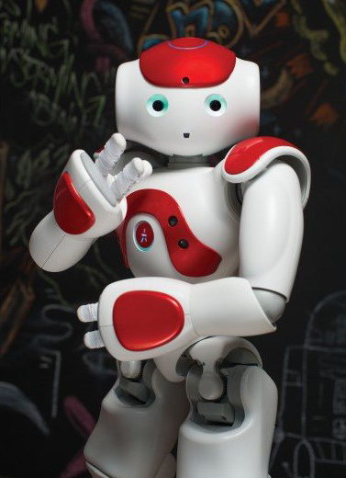
Klaus was diagnosed with Altzheimer‘s disease 2 years ago
Anna, 42
Klaus‘ daughter
Teacher
Rowing Club
one son
lives in Hamburg
Klaus, 80
Anna‘s father
Engineer
Bridge Club
lives in Lübeck
Walis, 2
Klaus‘ dementia assistent
robot
lives with Klaus
Uses IBM cognitive technologies

Slide 4




Bringing WALIS to life with IBM Watson
App Notification
Image Recognition
Speech to Text
Text to Speech

Slide 5
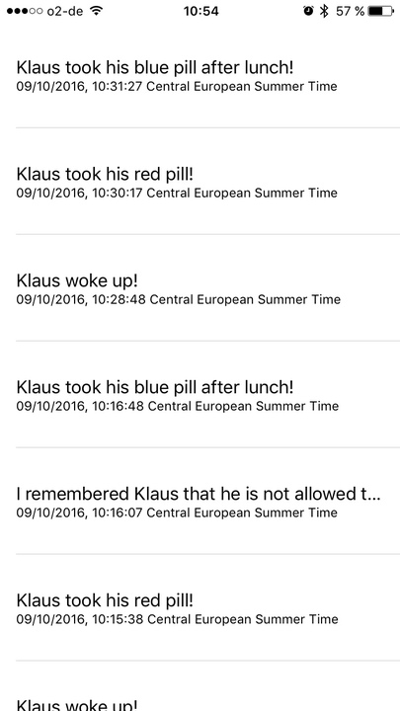
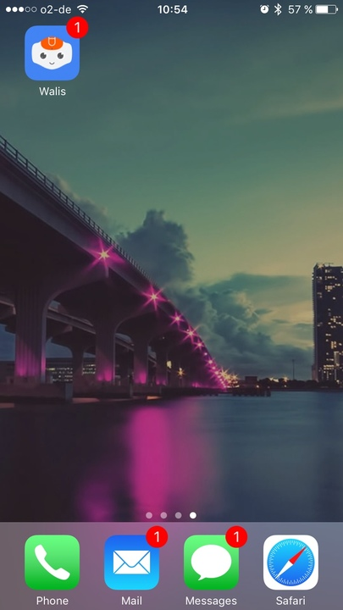
Bringing WALIS to life with IBM Watson

Slide 6
